Slide 1
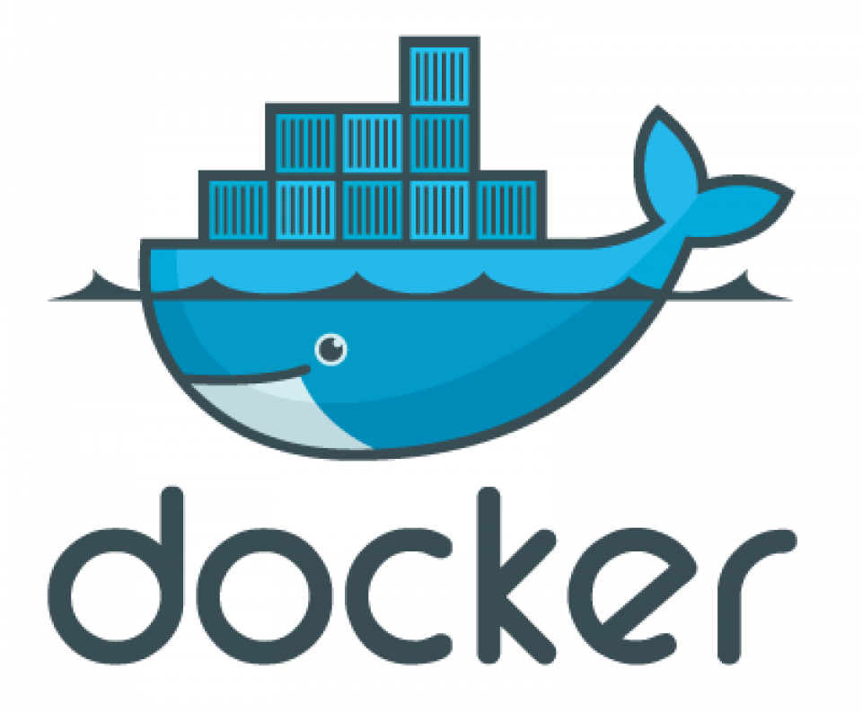
Introduction to Containerization

Slide 2
What is Containerization?
Containerization is a lightweight form of virtualization that allows developers to package and run applications along with their dependencies in isolated environments called containers.
Unlike traditional virtual machines, containers share the host system's operating system kernel but maintain isolated user spaces.

Slide 3
Key Concepts
Containers:
Encapsulated environments that include the application, its dependencies, libraries, and configuration files.
They ensure that the application runs consistently regardless of the environment.
Docker:
The most popular platform for creating, deploying, and managing containers.
It provides tools to package applications into containers, distribute them, and run them on any system with Docker installed.

Slide 4
Benefits of Containerization:
Portability
Scalability
Isolation
Efficiency

Slide 5
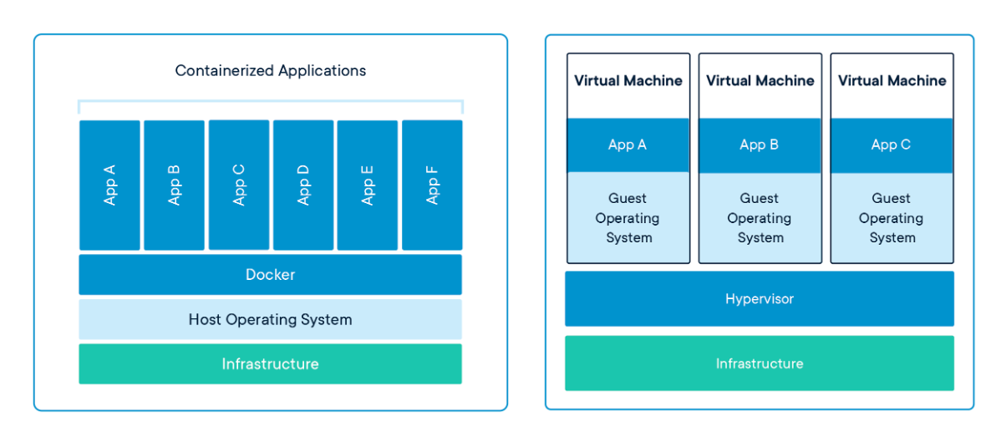

Slide 7
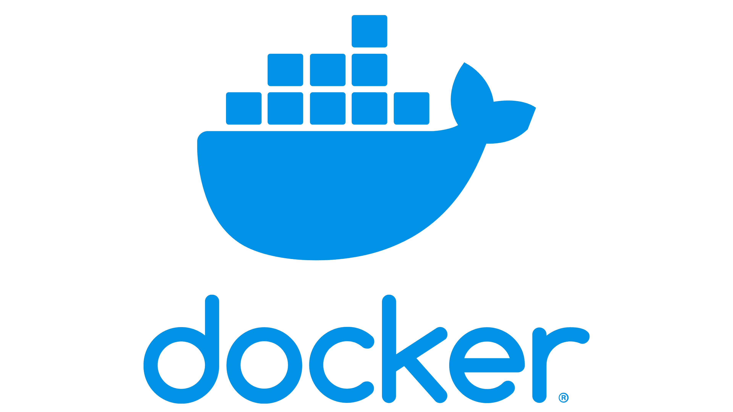
What is Docker
Docker is an open-source platform that automates the deployment, scaling, and management of applications inside lightweight, portable containers.

Slide 8
How Docker Works?
Create a Dockerfile: Developers write a Dockerfile with instructions on how to set up the environment and run the application.
Build an Image: Use the Docker CLI to build an image from the Dockerfile using the command docker build.
Run a Container: Use the built image to run a container using the command docker run. This starts an instance of the image and runs the application inside it.
Manage Containers: Use Docker CLI commands to manage running containers, such as starting, stopping, and removing containers.

Slide 9
Docker Terms
Docker Engine:
The core component of Docker, consisting of a server & a REST API for interacting with the daemon, as well as a command-line interface (CLI) client.
Docker Images:
Read-only templates that contain the application & all its dependencies, libraries, binaries, and other files necessary to run the application.
An image is built from a Dockerfile.

Slide 10
Docker Terms
Docker Containers:
Instances of Docker images.
Containers are lightweight, portable, and isolated environments that run applications.
They share the host system's OS kernel but maintain their own filesystem, processes, and network interfaces.

Slide 11
Docker Terms
Dockerfile:
A text file that contains a series of instructions on how to build a Docker image.
It defines what goes on in the environment inside your container.
Docker Hub:
A cloud-based repository where Docker users and partners create, test, store, and distribute Docker images.
It is the default registry for Docker images.

Slide 12
Installing Docker Client
Get the windows installer from the official docker website.
Docker desktop: https://www.docker.com/products/docker-desktop/
Double click and you can complete installer.

Slide 13
Activity 1
Docker installation
Check docker version
sudo docker version
sudo docker –v / sudo docker --version

Slide 14
Activity 2 commands
Docker Containers
sudo docker container ls
Docker Images:
sudo docker images
Docker Volume
sudo docker volume ls

Slide 15
Task 1
Run a Hello World Container:
Task: Pull and run the official Docker "Hello World" container.
Steps:
Use docker pull hello-world to pull the image.
Use docker run hello-world to run the container.
Observe the output to understand the basic Docker container lifecycle.

Slide 16
Activity 3: Pull images from Docker
Step 1: pull image
sudo docker pull docker/getting-started
Step 2: Check Image pulled
sudo docker images
Step 3: Run the image in docker container with some specific PORT Number
sudo docker run -p 80:80 docker/getting-started
Step 4: Exit the container
exit or ctrl+c
Step 5: Check the status of Running container
sudo docker ps –a
Step 6: Detach The container (run in detached mode)
sudo docker run -d -p 80:80 docker/getting-started
step 7: Check the status of Container
sudo docker container ps –a
check the output in the browser type localhost and you can see the output of getting started container

Slide 17
Step 9: Stop Container
check all the running container and get the name of you container which you want to stop
docker container ls
docker stop container_name
Step 10: Container Removal
docker ps –a
docker rm name_of_container
sudo docker rm -f name_of_container (use -f flag to remove container forcefully)

Slide 18
Giving Own name to container
sudo docker run -d -p 80:80 --name my_getting_started_app docker/getting-started
Check running container
Stop the same
Remove the same
Step 11: Remove Images
sudo docker images (get the image name which you want to remove)
sudo docker rmi name-of-image
sudo docker rmi -f name-of-image
(after removal check again the image removed or not) – docker images

Slide 19
Activity 4: Pull the ready images from docker hub
sudo docker pull ubuntu
sudo docker pull mysql
sudo docker pull mysql:5.7 (pull with version)
check images
sudo docker images
Remove 5.7 version image
sudo docker rmi mysql:5.7

Slide 20
Let's run mysql image in docker container
sudo docker run --name my_mysql_container -e MYSQL_ROOT_PASSWORD=123456 -d mysql
sudo docker container ls (see running container)
Connect with mysql
sudo docker exec -it my_mysql_container mysql -uroot –p
(enter your secret password and here we go you are connected with mysql)
create some queries and check.

Slide 21
Docker File
For Creating the Image we need to understand Docker file
its a file which doesn't contain any extention and its having some instructions written inside the same for creating/building a docker Image.
These instruction steps define steps needed to create an environment where you can run your application.

Slide 22
DockerFile terms
FROM
Specifies the base image to use for the subsequent instructions.
Every Dockerfile must start with a FROM instruction.
FROM ubuntu:20.04
RUN
Executes commands in a new layer on top of the current image and commits the results.
Commonly used to install software packages.
RUN apt-get update && apt-get install -y python3

Slide 23
DockerFile terms
CMD
Provides defaults for an executing container.
There can only be one CMD instruction in a Dockerfile. If multiple CMD instructions are provided, only the last one will be used.
CMD ["python3", "app.py"]
LABEL
Adds metadata to the image. Can be used for description, versioning, authorship, and other useful information.
LABEL maintainer="Sonam Soni <sonam@gmail.com>"

Slide 24
DockerFile terms
EXPOSE
Informs Docker that the container listens on the specified network ports at runtime.
EXPOSE 8080
ENV
Sets environment variables inside the container.
ENV APP_HOME /usr/src/app
ADD
Copies files, directories, or remote file URLs from the source to the destination path in the image.
ADD config.tar.gz /etc/config/

Slide 25
DockerFile terms
COPY
Similar to ADD, but only supports copying local files and directories.
COPY . /app
ENTRYPOINT
Configures a container that will run as an executable.
ENTRYPOINT ["python3", "app.py"]
VOLUME
Creates a mount point with the specified path and marks it as holding externally mounted volumes from the host or other containers.
VOLUME /data

Slide 26
DockerFile terms
WORKDIR
Sets the working directory for any RUN, CMD, ENTRYPOINT, COPY, and ADD instructions that follow it in the Dockerfile.
WORKDIR /app
USER
Sets the user name or UID to use when running the image and for any RUN, CMD, and ENTRYPOINT instructions that follow it.
USER appuser
ARG
Defines a variable that users can pass at build-time to the builder with the docker build command.
ARG build_version
RUN echo "Building version $build_version"

Slide 27
Let’s Create one Website & Dockerfile
Create one folder named mindsprint
Create index.html with some sample code
Create dockerfile without any extension in that.
Code Structure
mindsprint /
Dockerfile
index.html

Slide 28
Docker file Code
# Use the official Nginx image from Docker Hub
FROM nginx:alpine
# Copy the HTML file to the default Nginx public directory
COPY index.html /usr/share/nginx/html
# Expose port 80 to the host
EXPOSE 80

Slide 29
Build an Image and run as Container
docker build -t mindsprint
docker run -d -p 8080:80 mindsprint
http://localhost:8080 check your deployed website

Slide 30
Activity
Create one another website for Banglore-tourism
Deploy it on live server using apache server.
Create docker file
Build image
Check the created images
Run it as container and check localhost output

Slide 31
Dockerfile for apache
# Use the official Apache image from Docker Hub
FROM httpd:alpine
# Copy the HTML file to the default Apache public directory
COPY index.html /usr/local/apache2/htdocs/
# Expose port 80 to the host
EXPOSE 80

Slide 32
More than 1 file
#Copy the entire content of the local directory to the default Apache public directory
COPY . /usr/local/apache2/htdocs/
(. Represent an entire folder to copy into htdocs folder)

Slide 33
Backend App
Create one NodeJs application
App.js
Package.json
Install express package (npm install)

Slide 34
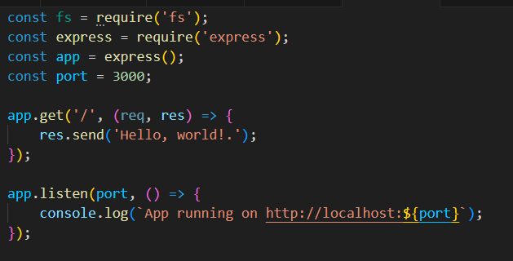
App.js file

Slide 35
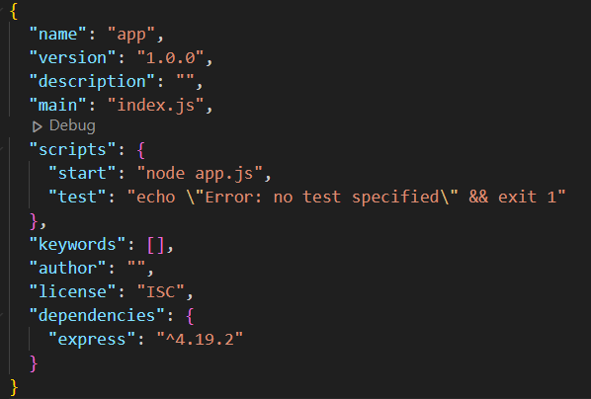
Package.json file

Slide 36
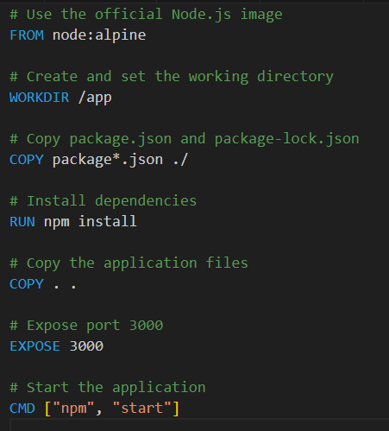
DockerFile

Slide 37
Deployment
Create an image
Deploy it on a container with port 3000
docker build -t docker-node-app .
docker run -d -p 3000:3000 -v docker-node-app

Slide 38
Dockerfile for Springboot
# Start with a base image containing Java runtime FROM openjdk:17-jdk-alpine # Set the working directory inside the container WORKDIR /app # Copy the packaged JAR file into the container COPY target/myapp-0.0.1-SNAPSHOT.jar /app/myapp-0.0.1-SNAPSHOT.jar # Expose the port on which your Spring Boot application will run EXPOSE 8082 # Run the Spring Boot application ENTRYPOINT ["java", "-jar", "/app/myapp-0.0.1-SNAPSHOT.jar"]

Slide 39
Create Account to DockerHub
Open hub.docker.com
Create an account
let’s connect from docker
sudo docker login
prompt with username: enter your docker username
password: type your password (The password which you type is not visible for security reasons) just press enter
If all good you will connected with your docker hub.

Slide 40
Push Image to docker hub
Create Tag to your Docker Images
sudo docker tag imagename sonamsoni/myimage
Push Image to your Docker account
sudo docker push sonamsoni/myimage
Once its uploaded check docker hub to see the image uploaded

Slide 41
Docker Volumes
Volumes are the storage, where we can persist our data generated by docker containers.
Using that we can share data between containers and also between container and host.
Docker Volumes are stored outside the container's filesystem so if you want to see your data after your container stops or remove you can check the same.
Let's create one Volume
sudo docker volume create my_volume
Let's run image in one container with volume
sudo docker run -d --name my_container -v my_volume:/data imagename

Slide 42
container created with Name: my_container
attached with volume: my_volume
stores the containers data inside: /data directory
Get List of Volumes
sudo docker volume ls
Inspect a perticular volume
sudo docker inspect my_volume (my_volume is the volume name)

Slide 43
Container commands
See exited container:
docker ps -a --filter status=exited
Remove all exited containers
docker container prune
Above command prompt with confirmation
To bypass that confirmation use
docker container prune -f

Slide 44
Network Docker Containers:
Task:
Create and use a custom Docker network to connect multiple containers.
Steps:
Create a Docker network using
docker network create my-network.
Run a container named container1 & container2 and connect it to my-network:
docker run -d --name container1 --network my-network nginx
docker run -d --name container2 --network my-network nginx

Slide 45
Verify Connectivity:
Access container2 from container1 using its container name as the hostname:
docker exec -it container1 bash
(this cmmand insert you in container 1)
Execute below commands to install ping in container1
apt update
apt install iputils-ping
ping container2 (type this command)
This command verifies that container1 can reach container2 over the my-network.
CleanUp:
docker container stop container1 container2
docker network rm my-network

Slide 46
Docker volumes
When we create a container its provides a storage but its not persitence.
When we remove the container we will loose our data.
Using Volumes we can persist data after deleting container as well.
How to create:
docker volume create my_volume
To verify:
docker volume ls
docker volume inspect my_volume (to get all details of Volume)
Run container using volume:
docker run --name server1 -d -v my_volume:/data -p 8080:80 nginx
docker ps

Slide 47
Docker volumes
let's create some file to the container
docker exec -it server1 bash
in bash:
cd /data
echo "Hello from Container1" > file1.txt
ls
cat file.txt
exit
stop and remove the container and then check the volume data again
Data remains there

Slide 48
Docker volumes
If you want to access the volume you can create any container and you can use it
You can also create temporary container and you can see the content.
docker run --rm -it -v my_volume:/storage alpine sh
/ # cd data
/data # ls
/data # cat file1.txt
/data # exit
Or you can use busy box image:
docker run --rm -it -v my_volume:/test busybox sh

Slide 49
Bind Mounts
Bind mounts for File Sharing
Share file between the host and the container
Created a folder host_diretory in C: drive
create index.html file and add some content
Now we want to mount this to our container
docker run -d -it --name devtest -v C:/host_directory:/usr/share/nginx/html -p 8080:80 nginx
Once its deployed check localhost:8080 you can see the content Mounted.

